Slide 1
Unit 1
Protocols and Client/Server Applications
Protocols: SMTP, E-mail Message (RFC22), PGP, POP, IMAP, HTTP, FTP

Slide 2
Simple Mail Transfer Protocol (SMTP)
Simple Mail Transfer Protocol (SMTP) is an Internet standard for Electronic mail (e-Mail) Transmission
IT was first defined by RFC 821 Later Extended by RFC 5321 which is widely use today.
SMTP by default uses TCP port 25. The protocol for mail submission is the same, but uses port 587. SMTP connections secured by SSL/TSL, known as SMTPS, default to port 465
Electronic mail servers and other mail transfer agents use SMTP to send and receive mail messages, user-level client mail applications typically use SMTP only for sending messages to a mail server for relaying. For receiving messages, client applications usually use either POP3 or IMAP

Slide 3
How it Works
Email is submitted by a mail client (MUA, mail user agent) to a mail server (MSA, mail submission agent) using SMTP on TCP port 587.
Most mailbox providers still allow submission on traditional port 25. From there, the MSA delivers the mail to its mail transfer agent (MTA, mail transfer agent)
MTA has to locate the target host. It uses the Domain name system (DNS) to look up the mail exchanger record (MX record) for the recipient's domain
The returned MX record contains the name of the target host. The MTA next connects to the exchange server as an SMTP client
Once the MX target accepts the incoming message, it hands it to a mail delivery agent (MDA) for local mail delivery. An MDA is able to save messages in the relevant mailbox format. Again

Slide 4
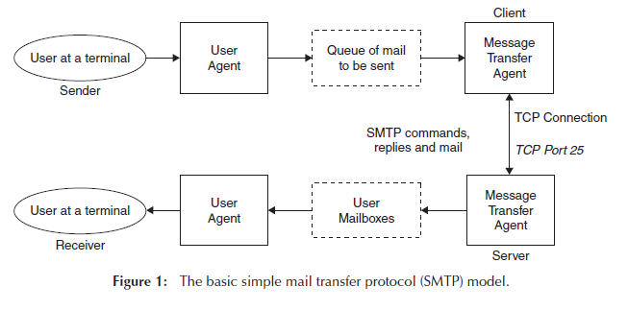
Block Diagram of SMTP

Slide 5
SMTP Protocol overview
SMTP is a connection-oriented, text-based protocol in which a mail sender communicates with a mail receiver by issuing command strings and supplying necessary data over a reliable ordered data stream channel, typically a Transmission Control Protocol (TCP) connection.
An SMTP session consists of commands originated by an SMTP client and corresponding responses from the SMTP server (the listening agent, or receiver) so that the session is opened, and session parameters are exchanged.
A session may include zero or more SMTP transactions. An SMTP transaction consists of three command/reply sequences.
MAIL command, to establish the return address This is the address to which bounce messages should be sent.
RCPT command, to establish a recipient of this message.
DATA to signal the beginning of the message text;

Slide 6
Electronic mail Message
E- mail is a method of exchanging digital messages from an author to one or more recipients.
Email is text messages that may contain files, images or other attachments sent through a network to a specific individual or groups
Modern email operates across the Internet or other computer networks.
Some early email systems required that the author and the recipient both be online at the same time, in common with instant messaging
An Internet email message consists of three components,
the message envelope,
the message header,
the message body.

Slide 7
Electronic Mail Types
Web Based Mail
Web-based email allows you to manage your email via a web browser.
The interface is implemented as a Web site that provides access to the various functions like reading, sending or organizing messages.
Email isn't downloaded to your computer but instead is left on the mail server until you delete it
Client Based Mail / (POP mail)
In Client Based email account, email messages are downloaded to the client device (i.e. a computer) and then they are deleted from the mail server . It is difficult to save and view messages on multiple devices.
An advantage to client-based mail is you can store as much email on your computer as you want and save it for as long as you would like. The only limit is the size of your hard drive
Another advantage is being able to read, write and reply to email while you are off-line

Slide 8
Pretty Good Privacy (PGP)
Pretty Good Privacy was originally developed by Phillip Zimmerman to provide a means of secure communication in an insecure electronic environment.
The framework it is based on, PKI (Public Key Infrastructure) and its encryption standards (it can use Diffie-Helman or RSA algorithms of varying strengths), have been subjected to rigorous cryptanalysis.
Until the most recent release PGP has been completely open source, allowing anyone to review the code and suggest improvements.

Slide 9
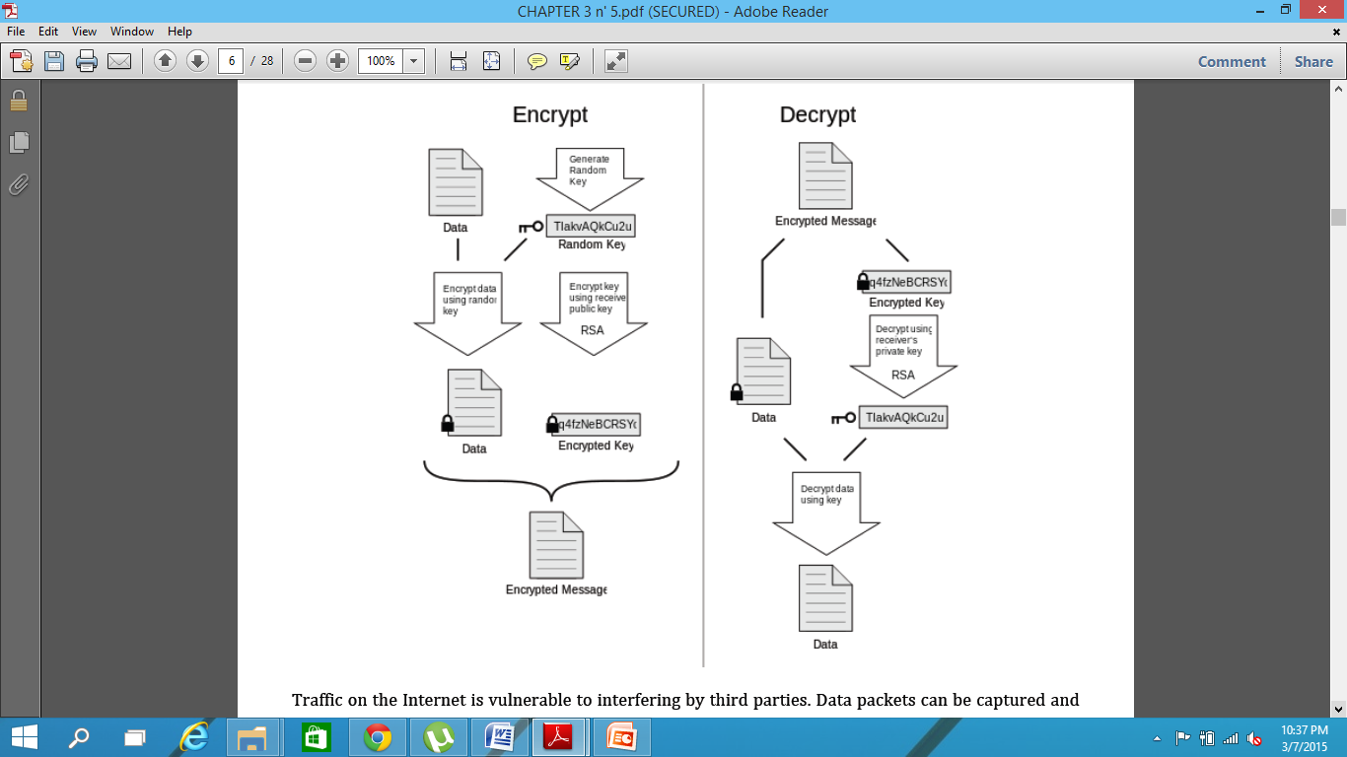
How it Works

Slide 10
Contd..
When someone starts using PGP, they generate a Key Pair. These are really just text files that look like gibberish to a human.
The keys can be created at various levels of strength – 512, 1024, or 2048 bit strengths are used. The higher the number, the stronger the encryption value of the key.
One key of the pair is the Private key – this key should always be kept safe and never given to anyone. The other key is the public key – this key should be given to as many people as possible
if user A wants to send an encrypted message to user B, user A would first obtain user B’s public key. This is possible because public keys are meant to be widely distributed.
Then user A encrypts the message using user B’s public key. The encrypted message can now only be decrypted with B’s private key, which only he possesses. Not even user A, who wrote the message, can decrypt what he has encrypted, because he does not possess user B’s private Key.

Slide 11
What are the uses of PGP
The most commonly used aspect of PGP is the signing and encryption of email or files. “Signing” a document is a way of verifying the integrity of the original work. The method is as follows:
Make a digest or “hash” of the file or email. A hash is an algorithm that produces (theoretically) a unique output (the hash) from a given input (the message).
Add the hash to the end of the message.
When someone wants to verify that the message has not been modified, they run the hash algorithm on the message and compare it to the hash at the end of the message. If the signatures match, the message has not been altered

Slide 12
Post office Protocol (POP)
Post Office Protocol (POP) is an application-layer Internet standard protocol used by local e-mail clients to retrieve e-mail from a remote server over a TCP/IP connection
POP has been developed through several versions, with version 3 (POP3) being the current standard.
IT is an offline protocol, POP3 retrieves messages from the server (either at an ISP or on a LAN) and transfers them to a workstation’s hard disk.
It deletes the messages from the server if this option is explicitly mentioned in the configuration.
In short, POP3’s function is to get email from a remote mailbox and store it on a user’s local machine so it can be read later in a disconnected or “offline” state.
POP3 is designed as a single user, single mailbox system (one account per user). The POP3 connector is usually a combined POP3 retriever and SMTP sender.
It normally uses port 110.

Slide 13
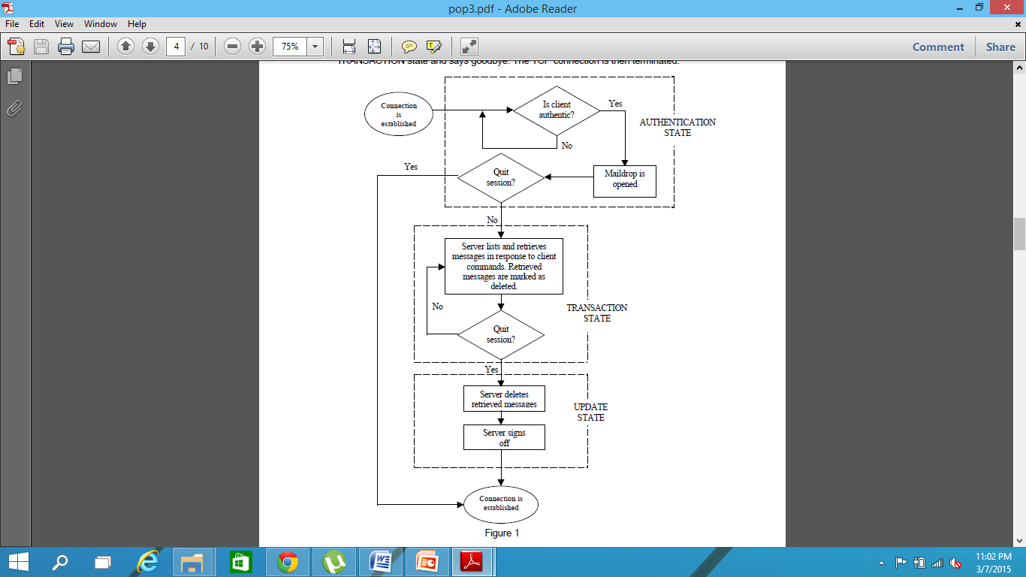
Working of POP
POP3 is an important component of Internet electronic mail.
While SMTP is designed to put mail into the mailbox from the Internet, POP3 is designed to retrieve mail from the mailbox and deliver them to their recipients.
users need to download their mail and close server connection before they can read their mail. To get more mail, they have to establish connection with the server again.
In addition, in using POP3, a user’s password is transmitted in the clear over the network.
Unlike POP3, IMAP can function both as an “offline” and an “online” protocol. IMAP also implements a security feature similar to that provided by the APOP command in POP3.

Slide 14
Advantage & Disadvantage
Advantages of POP:
Emails are downloaded to the user’s computer. Messages can be read when user is offline.
Opening attachments is quick and easy as they are already downloaded.
Less server storage space required; all emails are stored on local machine.
Storage capacity of emails limited by the size of your hard disk.
Very popular, easy to configure and use.
Disadvantages of POP:
Emails cannot be accessed from other machines (unless configured to do so).
Exporting the local mail folder to another email client or physical machine can be difficult.
Email folders can become corrupted, potentially losing the entire mailbox at once.
Email attachments may contain viruses which may expose the user’s PC to harm if they are opened locally and their virus scanner is unable to detect them

Slide 15
Internet Message Access Protocol (IMAP)
Internet Message Access Protocol (IMAP) is a protocol for e-mail retrieval and storage as an alternative to POP.
The Internet Message Access Protocol (commonly known as IMAP) is an Application Layer Internet protocol that allows an e-mail client to access e-mail on a remote mail server. The current version, IMAP version 4, is defined by RFC 3501.
An IMAP server typically listens on well-known port 143.
IMAP over SSL (IMAPS) is assigned well-known port number 993
IMAP, unlike POP, specifically allows multiple clients simultaneously connected to the same mailbox, and through flags stored on the server, different clients accessing the same mailbox at the same or different times can detect state changes made by other clients

Slide 16
How It Works
A sender sends email. An SMTP server transports.
An email server stores the mail for the user to access. And here ends the similarities.
When the receiver contacts the email server using an IMAP client the mail normally stays on the server.
The receiver can read the mail, move it into another folder on the server or copy it to a public folder to share with others
IMAP is more complex. By keeping email on the server it enables access to email from multiple computers. Its multiple-folder system provides for content sharing
IMAP supports both on-line and off-line modes of operation

Slide 17
Email Delivery Models
Email delivery models describe how email servers and email clients work together. There are three different models of how to deliver email on the Internet
Offline
In this model, a client goes online with an email server, downloads the mail, then goes offline. All mail and attachments are stored on the client machine and deleted from the email server
Online
With the online model, the client connects to the server and stays connected while the user processes the mail. In addition to processing the email, the user can add, change and delete email mailbox folders for personal and public accounts. Multiple users can simultaneously access a single public folder. All mail is stored on the server

Slide 18
Benefit & Drawback
IMAP Benefits
Multiple Client Support. Messages can be viewed on any computer with an IMAP client.
Public and group folders. Because they are on the server everyone can see and use them.
Configurability. It has dozens of options based on all three mail delivery models.
IMAP Drawbacks
Future Shock. Too many options.
Server Intensive. Consumes server CPU and disk resources

Slide 19
Hypertext Transfer Protocol (HTTP)
The Hypertext Transfer Protocol (HTTP) is an application protocol for distributed, collaborative, hypermedia information systems. HTTP is the foundation of data communication for the World Wide Web
It is Protocol for transfer of various data formats between server and client (Plaintext, Hypertext, Images, Video, Sound ) and Meta –information
Hypertext Transport Protocol is a Language of the Web, protocol used for communication between web browsers and web servers, use TCP port 80 (443 secure)
Hypertext is structured text that uses logical links (hyperlinks) between nodes containing text. HTTP is the protocol to exchange or transfer hypertext
The standards development of HTTP was coordinated by the Internet Engineering Task Force (IETF) and the World Wide Web Consortium (W3C), culminating in the publication of a series of Requests for Comments (RFCs), most notably RFC 2616

Slide 20
Technical Overview
HTTP functions as a request-response protocol in the client-server computing model.
The client submits an HTTP request message to the server. The server, which provides resources such as HTML files and other content, or performs other functions on behalf of the client, returns a response message to the client. The response contains completion status information about the request and may also contain requested content in its message body.
HTTP is an application layer protocol designed within the framework of the Internet Protocol Suite. Its definition presumes an underlying and reliable transport layer protocol and Transmission Control Protocol (TCP) is commonly used. However HTTP can use unreliable protocols such as the User Datagram Protocol (UDP)
HTTP resources are identified and located on the network by Uniform Resource Identifiers (URIs)—or, more specifically, Uniform Resource Locators (URLs)—using the http or https URI schemes

Slide 21
HTTP - URLs
URL
Uniform Resource Locator
protocol (http, ftp, news)
host name (name, domain name)
port (usually 80 but many on 8080)
directory path to the resource
resource name
http://xxx.myplace.com/www/index.html
http://xxx.myplace.com:80/cgi-bin/t.exe

Slide 22
HTTP Request methods
HTTP defines methods to indicate the desired action to be performed on the identified resource.
The HTTP/1.0 specification defined 3 Method
GET
The GET method is used to ask for a specific document , when we click on a hyperlink, GET is being used
run a CGI with arguments attached to the URL
POST
The POST method is used to transfer block of data from the client to the server
more secure and private
HEAD
The HEAD method is used to ask only for information about a document, not for the document itself.
It's often used by clients who use caching, to see if the document has changed since it was last accessed

Slide 23
Contd..
HTTP/1.1 specification added 5 new methods:
OPTIONS
Returns the HTTP methods that the server supports for the specified URL. This can be used to check the functionality of a web server by requesting '*' instead of a specific resource.
PUT
Requests that the enclosed entity be stored under the supplied URI. If the URI refers to an already existing resource, it is modified; if the URI does not point to an existing resource, then the server can create the resource with that URI
DELETE
Deletes specified resource object, Usually Not allowed
TRACE
Echoes back the received request so that a client can see what (if any) changes or additions have been made by intermediate servers
CONNECT
Converts the request connection to a transparent TCP/IP tunnel, usually to facilitate SSL-encrypted communication (HTTPS) through an unencrypted HTTP proxy

Slide 24
HTTP Response Headers
Sent by server to client browser
Status Header
Entities
Content-Encoding:
Content-Length:
Content-Type:
Expires:
Last-Modified:
extension-header
Body – content (usually html)

Slide 25
Status Codes
200 OK
201 created
202 accepted
204 no content
301 moved perm.
302 moved temp
304 not modified
400 bad request
401 unauthorized
403 forbidden
404 not found
500 int. server error
501 not impl.
502 bad gateway
503 svc not avail

Slide 26
Statelessness
Because of the Connect, Request, Response, Disconnect nature of HTTP it is said to be a stateless protocol
i.e. from one web page to the next there is nothing in the protocol that allows a web program to maintain program “state” (like a desktop program).
“state” can be maintained by “witchery” or “trickery” if it is needed

Slide 27
similar Protocol and Future
The Gopher protocol was a content delivery protocol that was displaced by HTTP in the early 1990s. The protocol SPDY is also similar to HTTP, modifying the request-response interaction between client and server
HTTP-Next Generation
Many channels
One TCP connection carries multiple channels for parallel communication
Different protocols on each channel
Traditional way
Multiple TCP connections between same client and server
Pages contain images, video, audio, and html
Real-time protocols and the web
Streaming protocols
Audio/video-on-demand

Slide 28
File Transfer Protocol (FTP)
The File Transfer Protocol (FTP) is a standard network protocol used to transfer computer files from one host to another host over a TCP-based network, such as the Internet.
FTP is built on a client-server architecture and uses separate control and data connections between the client and the server. FTP users may authenticate themselves using a clear-text sign-in protocol, normally in the form of a username and password, but can connect anonymously if the server is configured to allow

Slide 29
Why do we need a FTP Service?
Purpose: To Transfer files between two computers
Goals of FTP Service
Promote sharing of files (programs and/or data)
Encourage indirect/implicit use of remote computers
Shield users from variations in file storage among hosts
Transfer data reliably and efficiently

Slide 30




Problems of File Transfer
At first, file transfer may seem simple
Heterogeneous systems use different:
Operating Systems
Character Sets
Naming Conventions
Directory Structures
File Structures and Formats
FTP need to address and resolve these problems

Slide 31
Communication and Data Transfer
FTP may run in active or passive mode, which determines how the data connection is established.
In both cases, the client creates a TCP control connection from a random unprivileged port N to the FTP server command port 21.
In active modes, the client starts listening for incoming data connections on port N+1 from the server (the client sends the FTP command PORT N+1 to inform the server on which port it is listening).
In situations where the client is behind a firewall and unable to accept incoming TCP connections, passive mode may be used.
In this mode, the client uses the control connection to send a PASV command to the server and then receives a server IP address and server port number from the server, which the client then uses to open a data connection from an arbitrary client port to the server IP address and server port number received
The server responds over the control connection with three-digit status codes in ASCII with an optional text message. For example "200" (or "200 OK") means that the last command was successful.

Slide 32
Data representations Mode
ASCII mode: Used for text. Data is converted, if needed, from the sending host's character representation to "8-bit ASCII" before transmission, and to the receiving host's character representation.
Image mode (commonly called Binary mode): The sending machine sends each file byte for byte, and the recipient stores the byte stream as it receives it.
EBCDIC mode: Used for plain text between hosts using the EBCDIC character set.
Local mode: Allows two computers with identical setups to send data in a proprietary format without the need to convert it to ASCII.
Stream mode: Data is sent as a continuous stream, relieving FTP from doing any processing. Rather, all processing is left up to TCP. No End-of-file indicator is needed, unless the data is divided into records.
Block mode: FTP breaks the data into several blocks (block header, byte count, and data field) and then passes it on to TCP.
Compressed mode: Data is compressed using a single algorithm (usually run-length encoding).

Slide 33
FTP login
FTP login utilizes a normal username and password scheme for granting access
The username is sent to the server using the USER command, and the password is sent using the PASS command.
If the information provided by the client is accepted by the server, the server will send a greeting to the client and the session will commence.
If the server supports it, users may log in without providing login credentials, but the same server may authorize only limited access for such sessions.
A host that provides an FTP service may provide anonymous FTP access.
Users typically log into the service with an 'anonymous' (lower-case and case-sensitive in some FTP servers) account when prompted for user name.
Although users are commonly asked to send their email address instead of a password, no verification is actually performed on the supplied data. Many FTP hosts whose purpose is to provide software updates will allow anonymous logins

Slide 34
Security
FTP was not designed to be a secure protocol, and has many security weaknesses and are following problems:
Brute force attacks
Bounce attacks (port scan)
Packet capture (packet sniffing)
Port stealing
Spoof attacks
Username protection
FTP does not encrypt its traffic, all transmissions are in clear text, and usernames, passwords, commands and data can be read by anyone able to perform packet capture (sniffing) on the network
It was designed prior to the creation of encryption mechanisms such as TLS (Transport Layer Security) or SSL (Secure Sockets Layer).
A common solution to this problem is to use the "secure", TLS-protected versions of the insecure.

